Slide 2
How to Build a Dynamics Portal Quickly Using OOTB Configuration

Slide 3
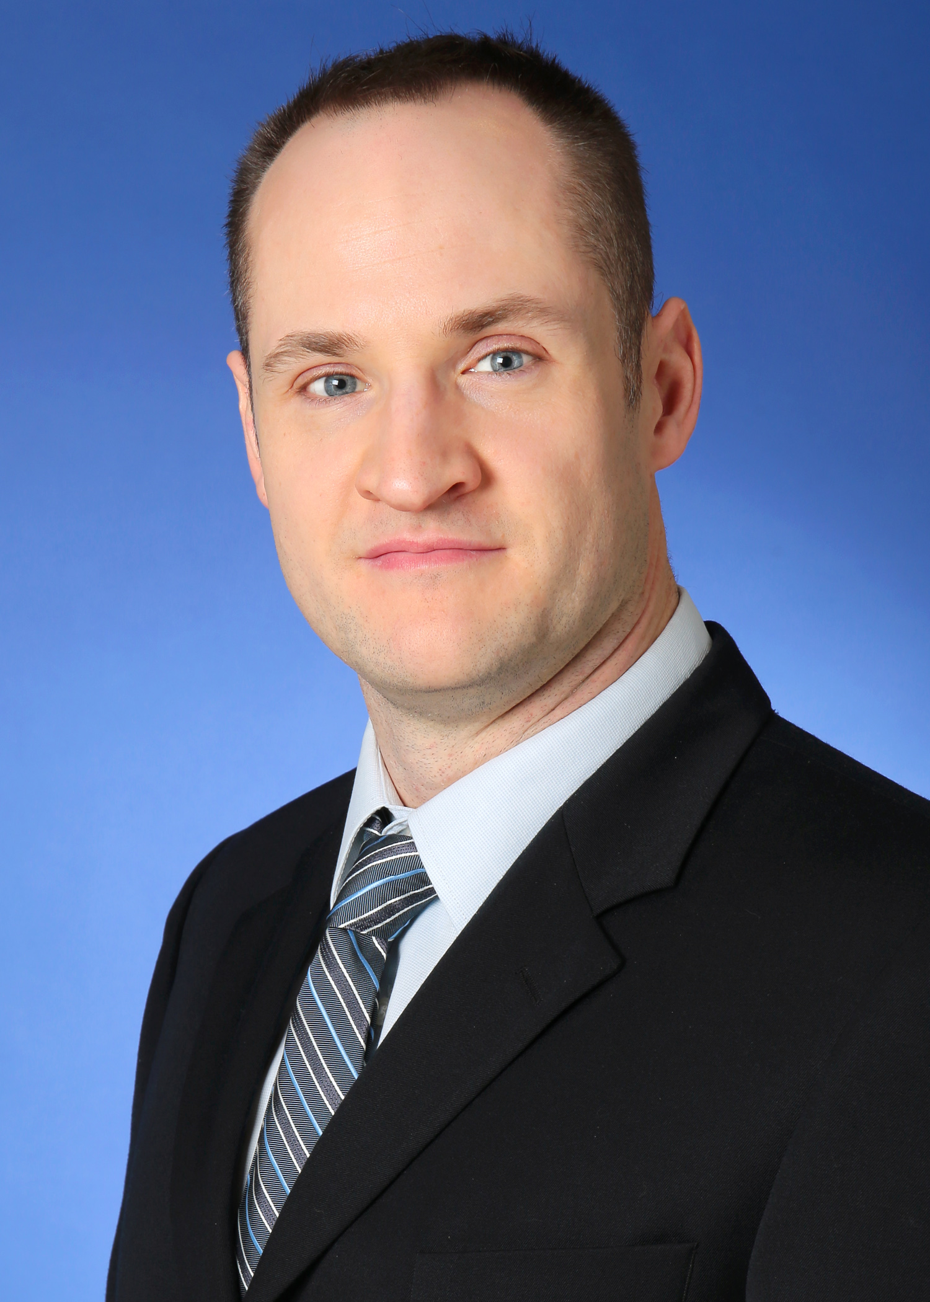
Robert Bailey
Functional CE Team Lead at KPMG Canada Microsoft Practice

Slide 4
Session Objectives
What will you learn today?
Learn what can be done OOB with Dynamics Portals
Learn about the Portal Management capabilities
Learn to Use the Create Portal Content wizard
How to construct a useful portal with no code

Slide 5
What’s a Dynamics Portal and how do I Get one?
Your very own customer, support, or prospect portal which is 100% housed, maintained, and integrated with your Dynamics 365 instance
No new hardware to procure, certificates to install, or web servers to provision
If you have a Dynamics 365 Enterprise subscription already, then you likely have at least one Dynamics 365 portal license already
Additional licenses available at extra cost
One Portal for free with each Dynamics instance

Slide 6
Portals Options
Embrace the Cloud – Use Dynamics 365 Portals
Point and click configurability
No access to code
Connect 365 framework
Out of Box Verticals
Customer Portal
Community Portal
Employee Portal
Partner Portal
Use Open Source Dynamics Portals
xRM Community Edition
Use 3rd-Party Portal Solutions

Slide 7
Portals Go Deep
Turnkey Portals Solutions
Customer Portal, Partner Portal, etc.
Additional Configuration allow for completely custom functionality using OOB Configuration
Learn the basics of managing Portals Entities
7

Slide 8
Portals Elements
Website Content
Site Navigation
Authorization & Authentication
Entity / Web Forms (for inserting & editing dynamics records)
Entity Lists (for displaying records from Dynamics)
Security Model & Entity Permissions
Styling & Layout

Slide 9
Scenario: Odd Jobs Board
Board for posting and accepting odd jobs in a community
Job posters can post a job
Job takers can apply for jobs
Job takers and Posters manage profiles

Slide 10
Thank you
Robert Bailey
KPMG Canada, Robert.bailey@Adoxio.com
Twitter @BaileyGregole
LinkedIn https://linkedin.com/in/robert-bailey-12735095/
Blog https://robert-bailey.blog/blog/
Please complete your surveys now
www.ugfocus.com/houston-survey

